Slide 1
COVID-MobileXpert: On-Device COVID-19 Patient Triage and Follow-up using Chest X-rays
Xin Li, Chengyin Li, Dongxiao Zhu
Department of Computer Science, Wayne State University, USA
Email: xinlee@wayne.edu
Source Code: https://github.com/xinli0928/COVID-Xray
Trustworthy AI Lab: https://sites.google.com/view/mlpa/mainpage

Slide 2
Outline
Introduction
Related Work
Approach
Experiments
Demo
Conclusion

Slide 3
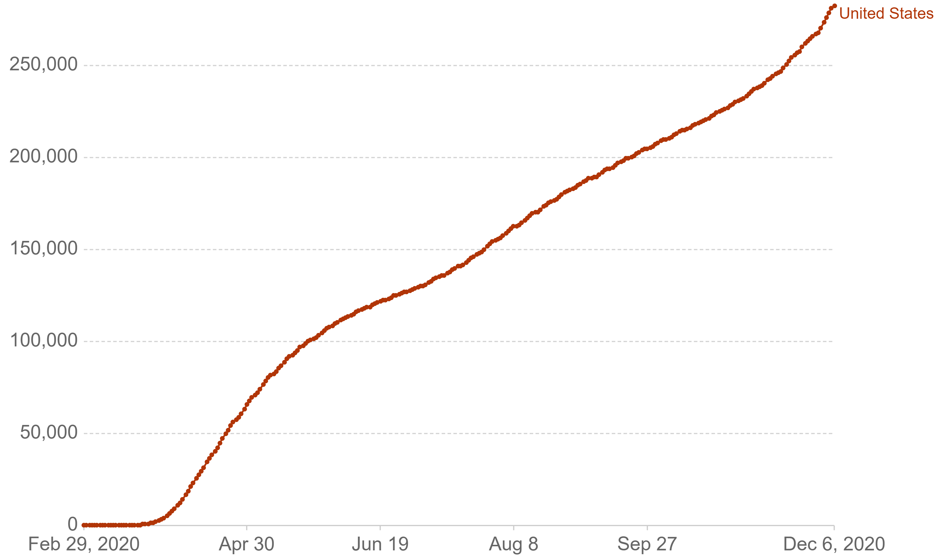
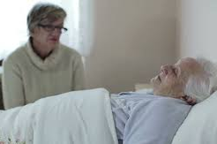
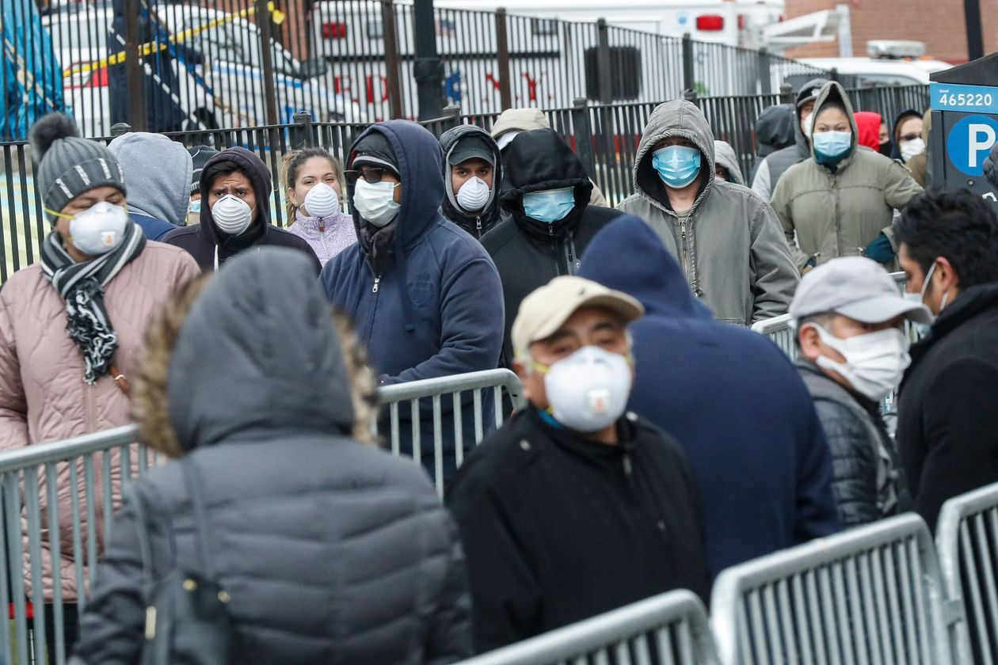
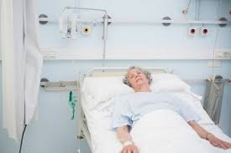
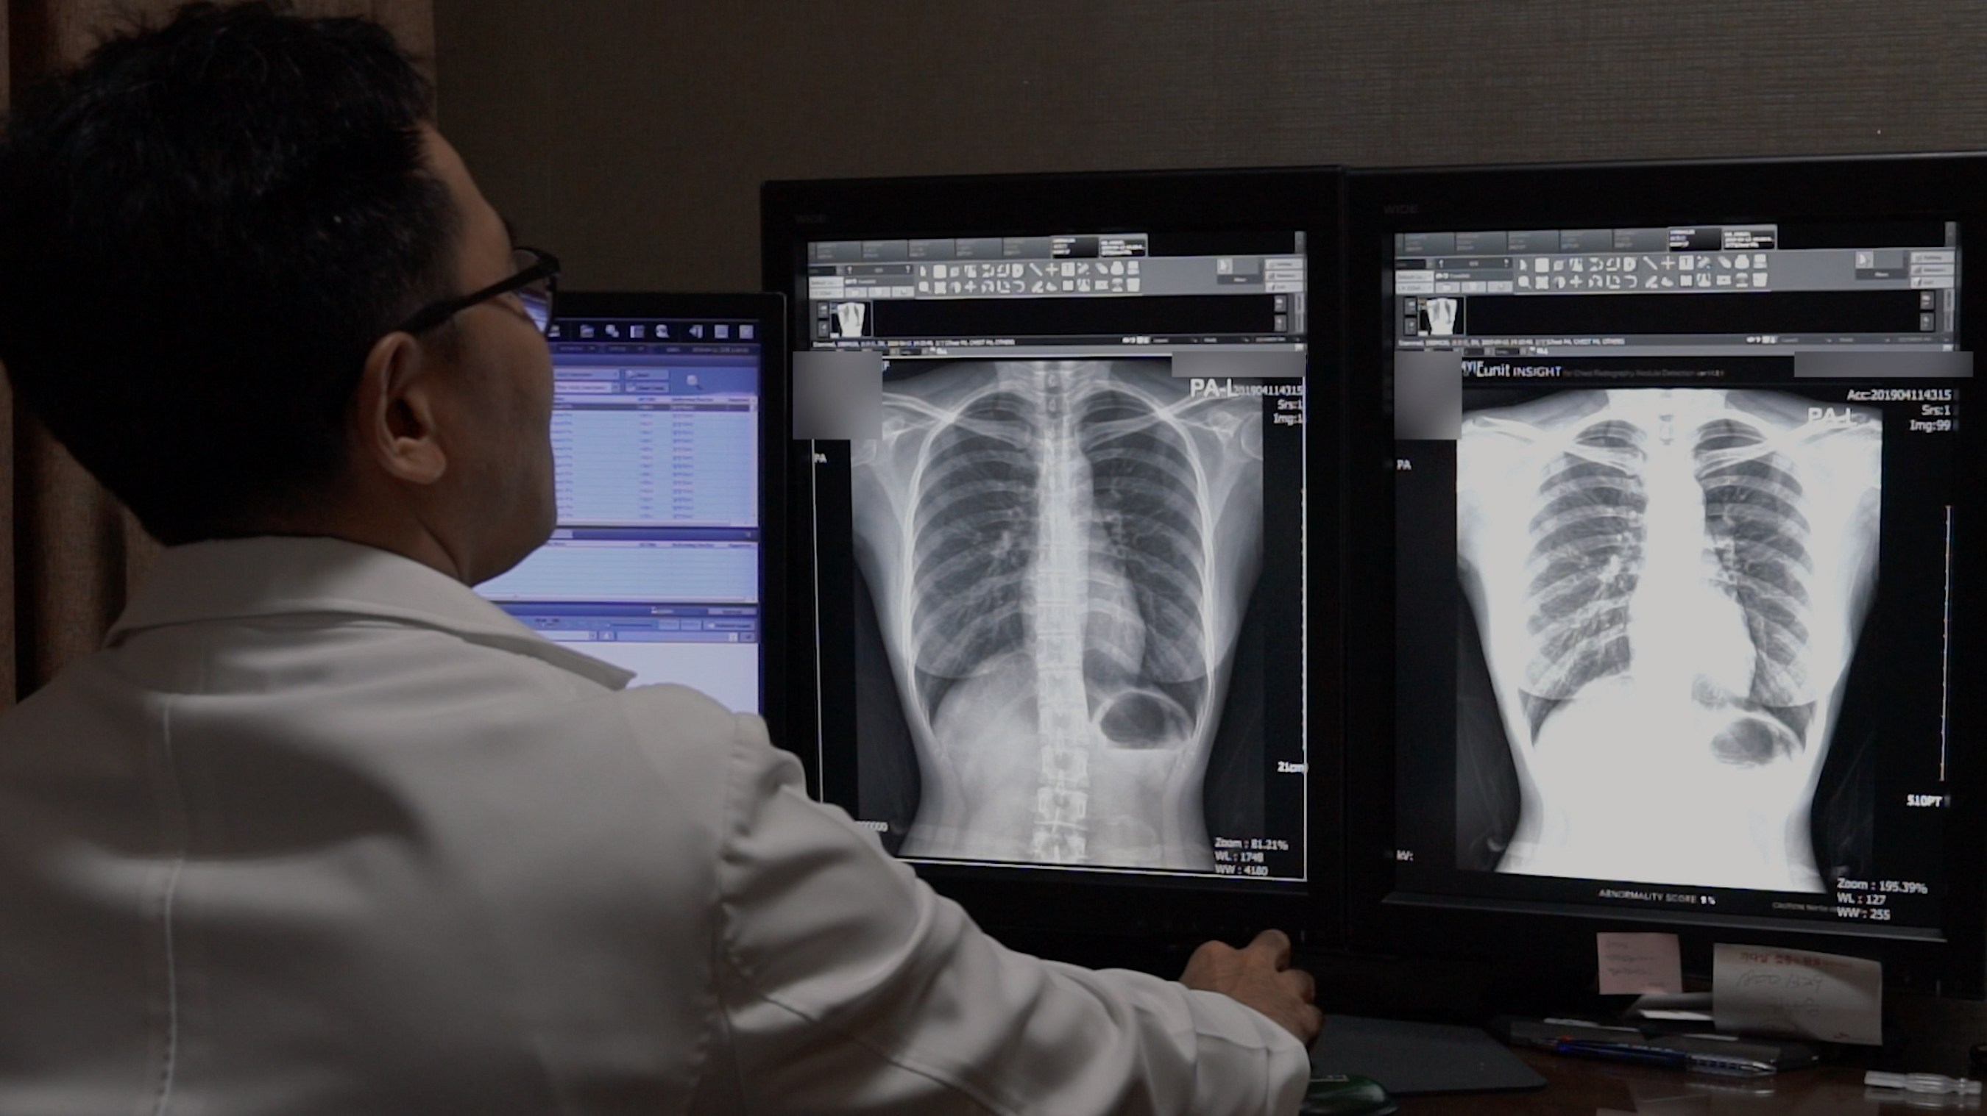
Introduction
Cumulative COVID-19 deaths in the U.S.
Over 280k deaths
About 8 out of 10 seniors
A rapid, dedicated, and point-of-care COVID-19 patient triage and follow-up techniques are needed
Reaching unreachable
Slow results
Follow-up needed
Specialist needed

Slide 4
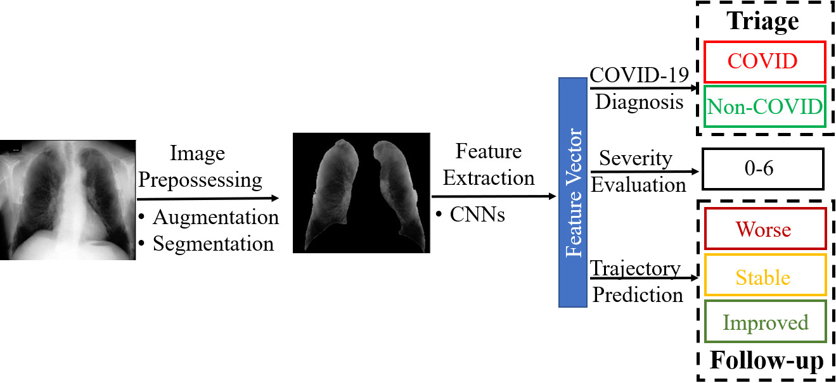
Related Work
Previous works:
Use large scale Artificial Intelligence (AI) models
Concentrate on triage
Make score level follow-up
COVID-MobileXpert:
Can be deploy on mobile AI system
Focus on both triage and follow-up
Make feature level follow-up
Workflow of COVID-19 X-ray interpretation systems

Slide 5
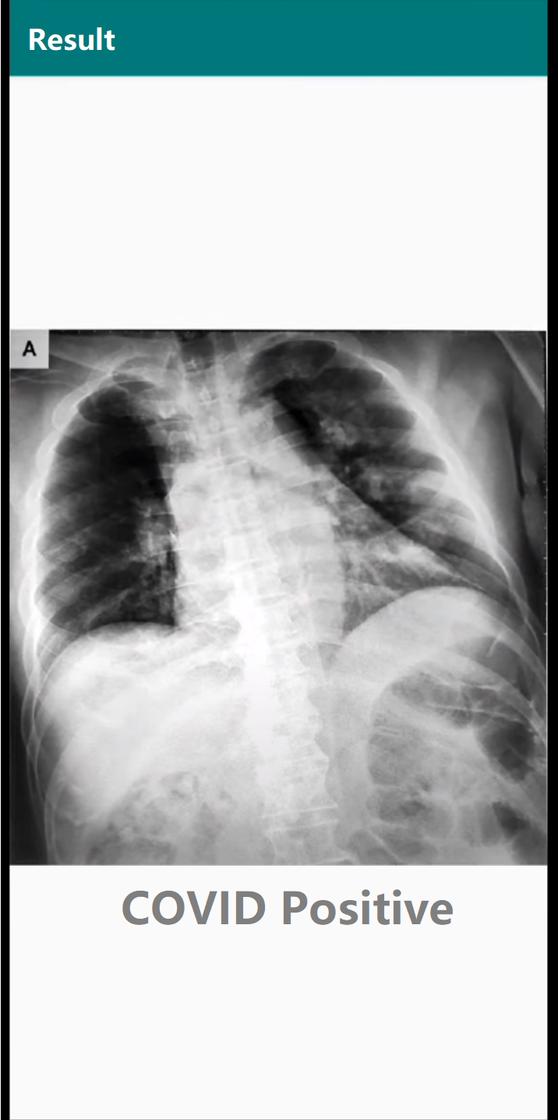
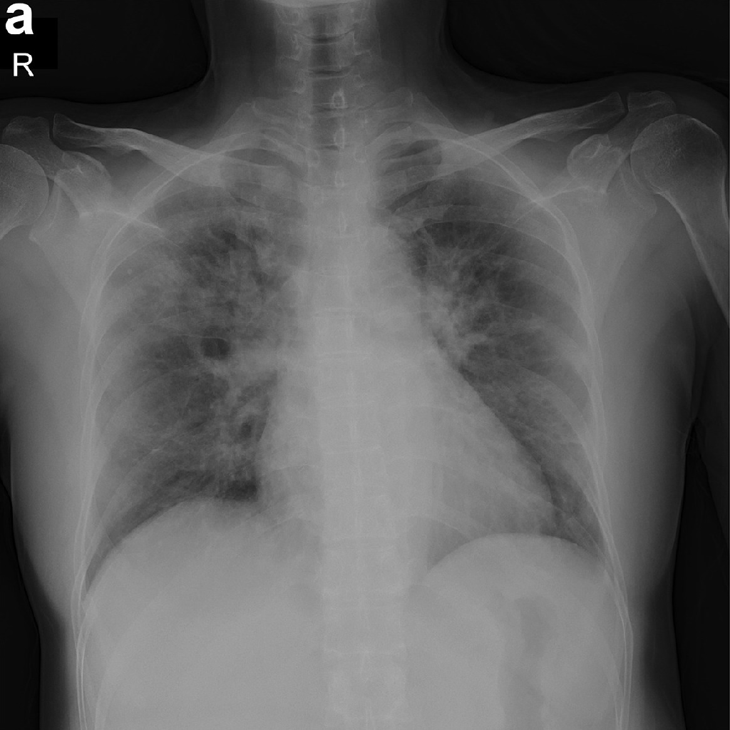


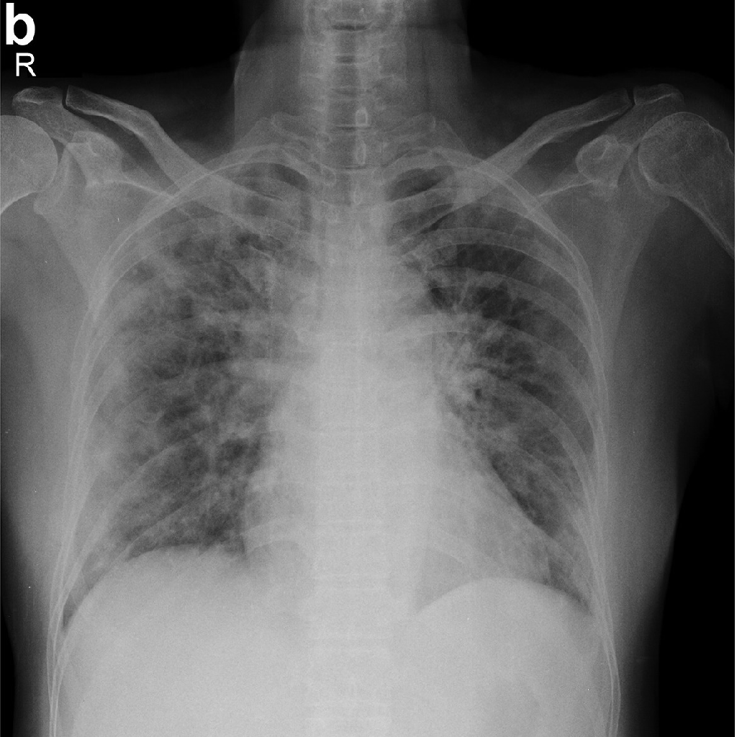
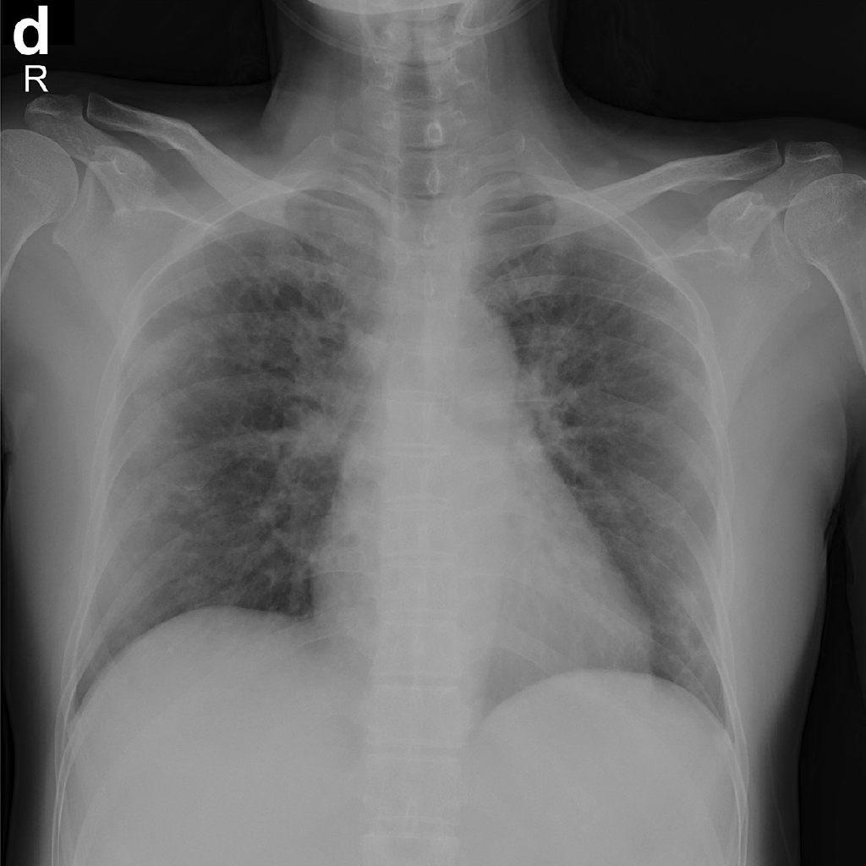
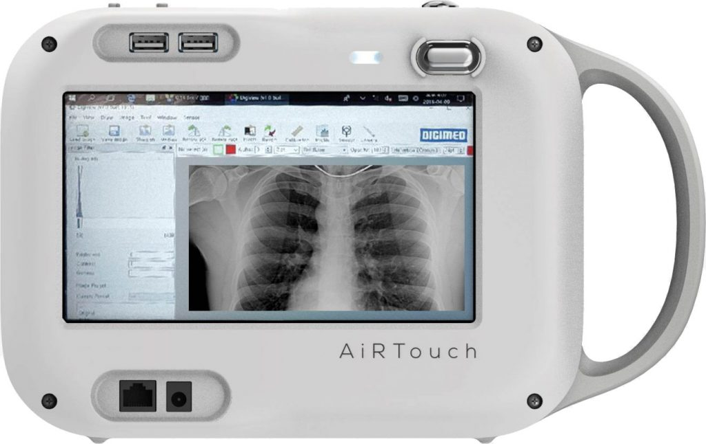

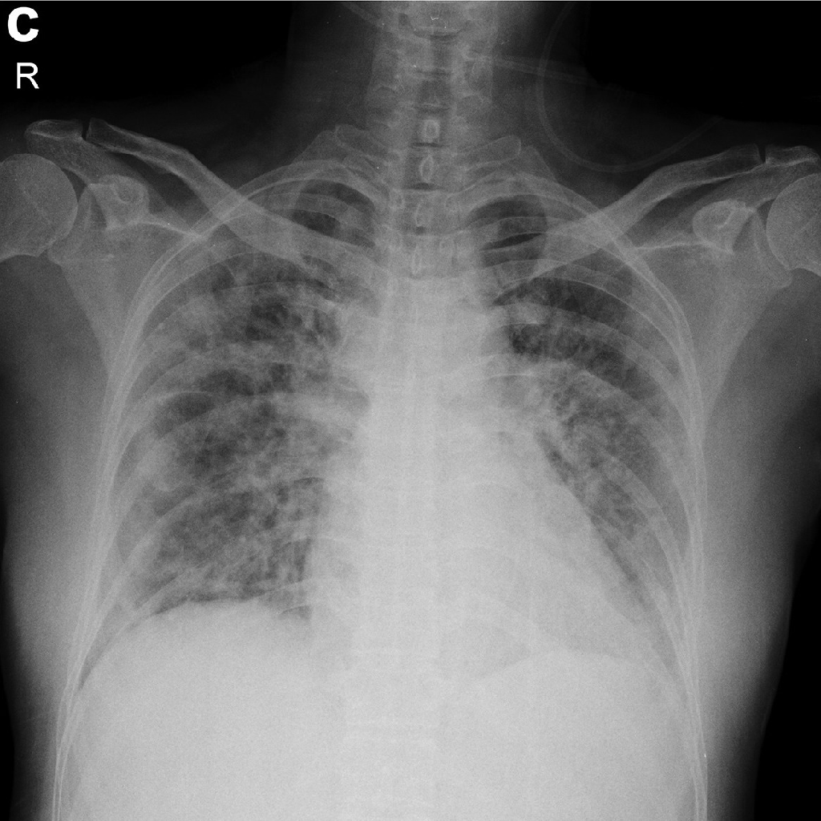
Triage
COVID-MobileXpert
Follow-up
Day 1
Day 2
Day 3
Day 4
Real-time results
Anyone
Anywhere

Slide 6
Approach
Unique challenges for on-device medical images interpretation:
label scarcity significantly limits the generalizability of the system
vastly similar and dominant fore- and background make it hard samples for learning the discriminating features between different classes
Our Solution:
three-player knowledge transfer and distillation (KTD) framework
probabilistically compact (PC) loss function

Slide 7
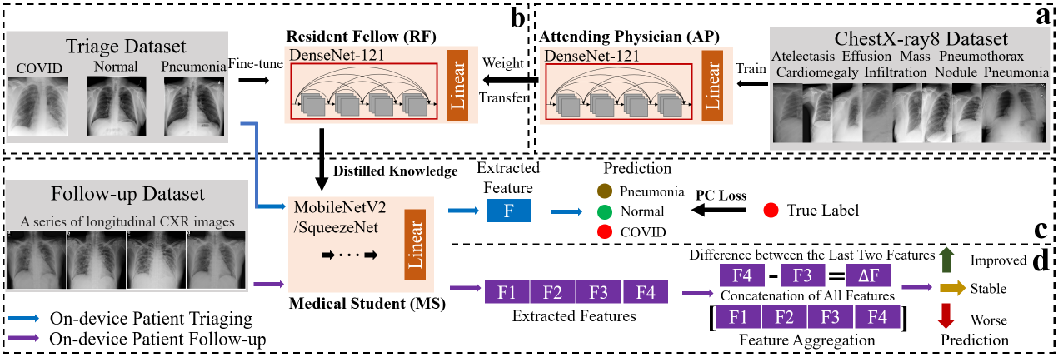
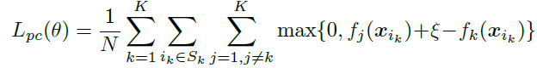
Approach
KTD framework
PC loss

Slide 8
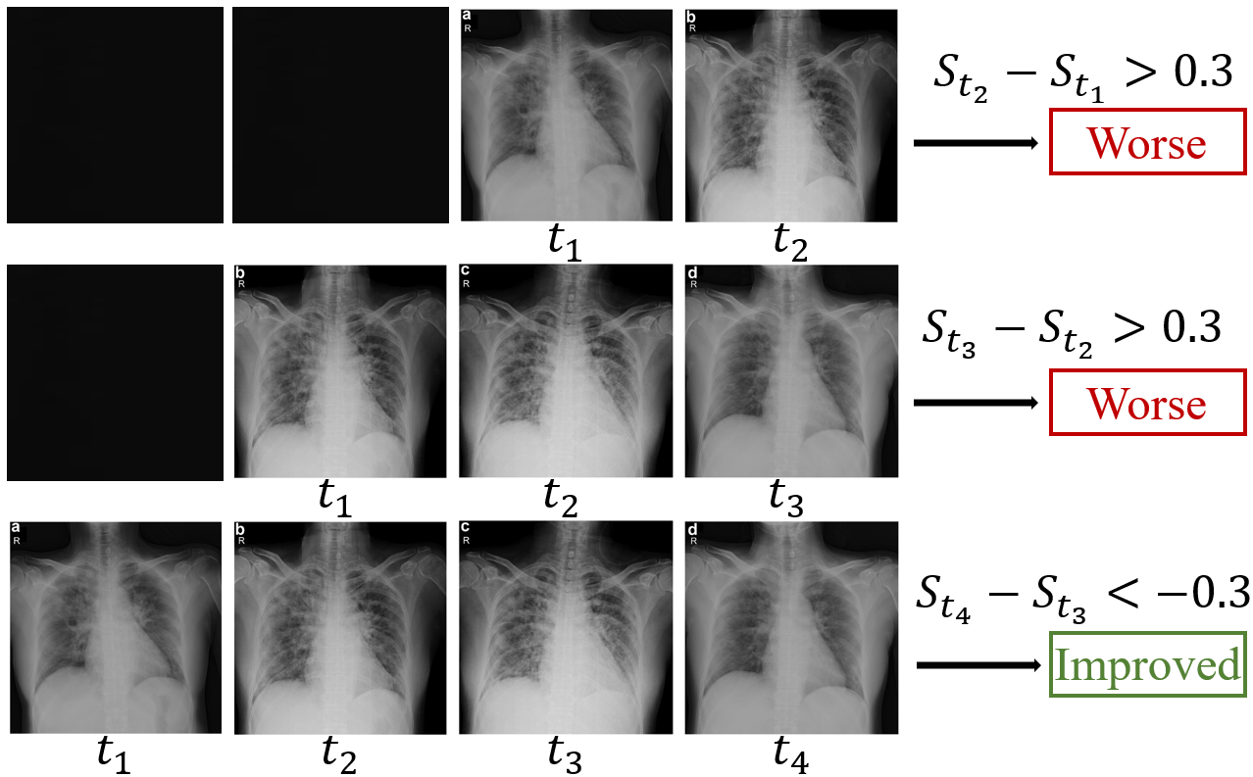
Experiments
Pre-training data (108,948 images):
The NIH ChestX-ray8 [1]
Triage data (537 images):
COVID-19 Image Data Collection [2]
RSNA Pneumonia Detection Challenge [3]
Follow-up data (159 sequences):
COVID-19 Image Data Collection [2]
An example of data preparation for follow-up data

Slide 9
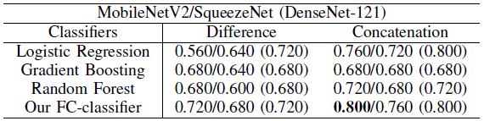
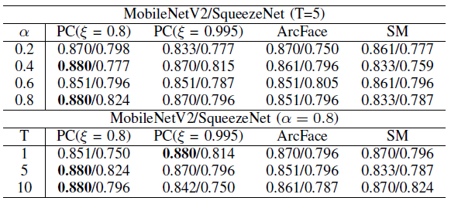
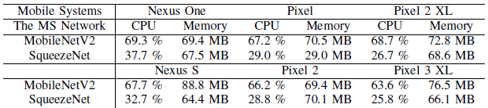
Experiments
Patient follow-up performance
Patient triage performance
Resource consumption on mobile systems

Slide 10
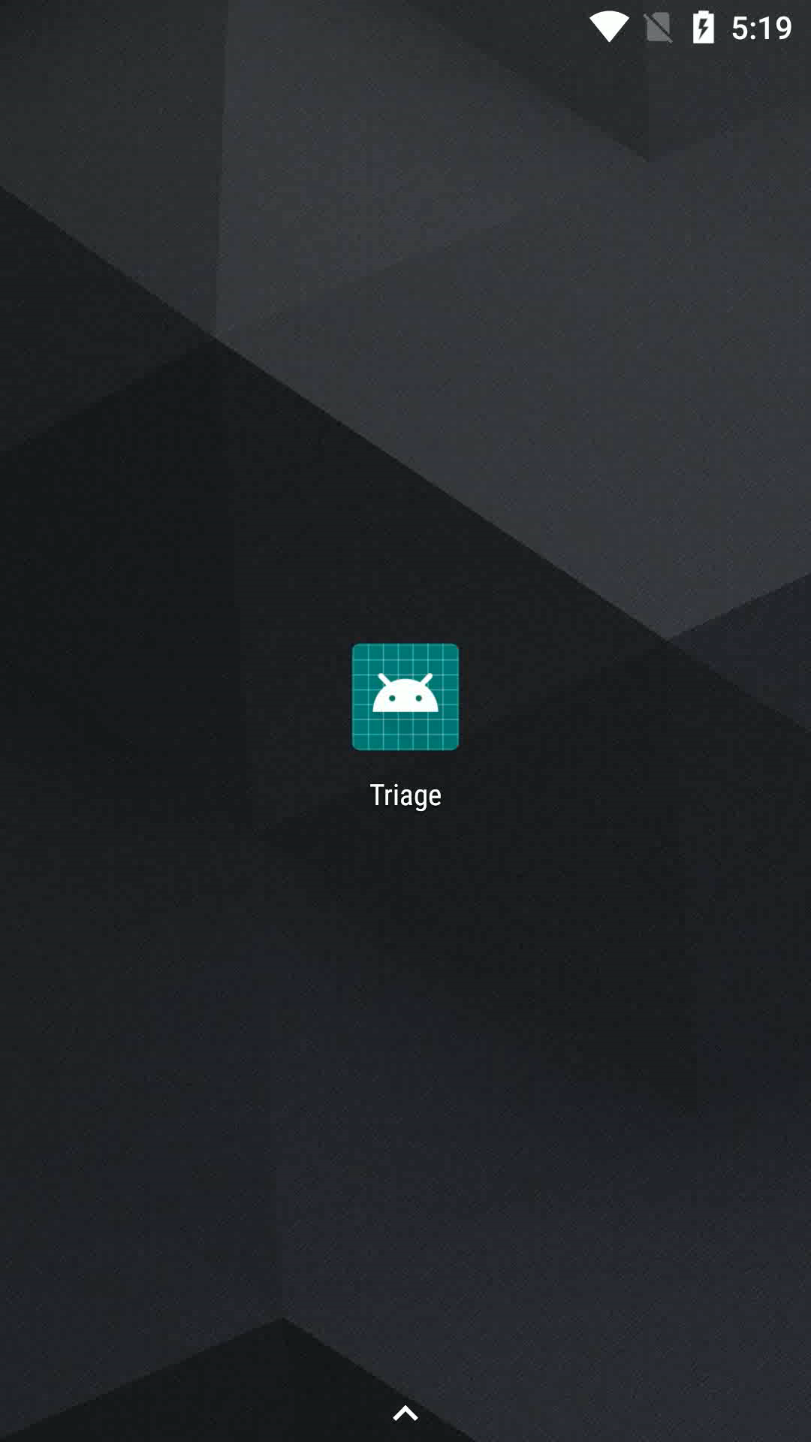
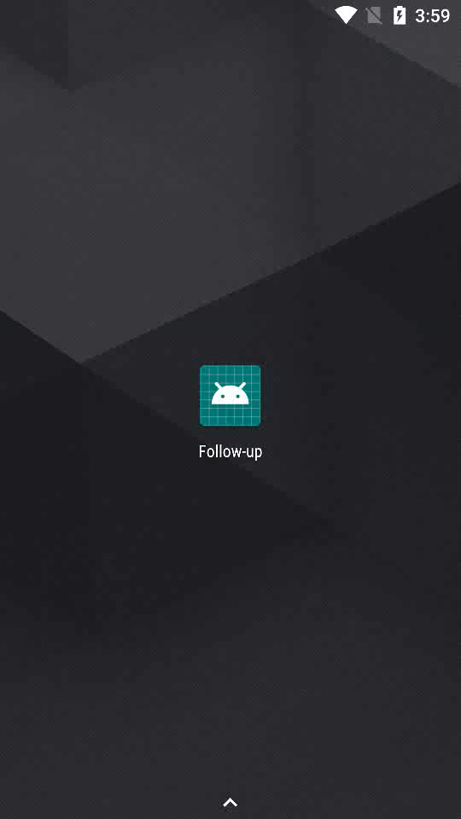
Demo
Triage
Follow-up

Slide 11
Conclusion
A rapid, dedicated, and point-of-care COVID-19 patient triage and follow-up techniques are needed during the pandemic
The proposed method tackle the unique challenge in on-device medical image interpretation by introducing novel three-player KTD framework and PC loss function
From a broader perspective, this approach is generally applicable to train other on-device medical imaging interpretation apps for point-of-care screening of other human diseases after COVID-19 pandemic

Slide 12
Thank you!
Email: xinlee@wayne.edu
Source Code: https://github.com/xinli0928/COVID-Xray
Trustworthy AI Lab: https://sites.google.com/view/mlpa/mainpage

Slide 13


Slide 14
Reference
[1] X. Wang, Y. Peng, L. Lu, Z. Lu, M. Bagheri, and R. M. Summers, “Chestx-ray8: Hospital-scale chest x-ray database and benchmarks on weakly-supervised classification and localization of common thorax diseases,” in 2017 IEEE Conference on Computer Vision and Pattern Recognition (CVPR), 2017, pp. 3462–3471.
[2] J. P. Cohen, P. Morrison, and L. Dao, “Covid-19 image data collection,” arXiv preprint arXiv:2003.11597, 2020.
[3] R. S. of North America, “RSNA pneumonia detection challenge,” https: //www.kaggle.com/c/rsna-pneumonia-detection-challenge, 2018.

